Slide 1
Marcus Tullius Cicero
The Heart of the Roman Republic

Slide 2
The Times of Cicero
As a student of Cicero it’s important to understand that Cicero was a key factor in the Roman Republic during its most tumultuous time; the First Triumvirate. Cicero, known for his oratorical skills and philosophical treatises, dedicated his life to the preservation of the Roman Republic and gave his life defending it in Rome’s political frontier; the Curia (Senate).

Slide 3

Cicero the Author
Much of Latin literature which survives today is that of Cicero’s. Nearly 75% of Roman literature is that of Cicero’s. His works come from the dates 90-43 BCE.
Cicero wrote in several genera varying from philosophical treatises based on Greek originals, epistles, mostly to his wife while in exile and his friend Atticus, some poetry (which does not survive), and mostly oratory.

Slide 4

Cicero’s Life
His cognomen, Cicero, means “chickpea”.
Born to a wealthy equestrian family on 3 January 106 BCE in Arpinum, a small town 60 miles south of Rome.
Had one brother named Quintus to whom he was very close.
His father took him and Quintus to Rome at a young age to receive and education. He studied under the orator Lucius Licinius Crassus, then the former consul Quintus Mucius Scaevola the Augur, and finally under the Greek poet Archias whom he later defended in court. Archias was accused of gaining Roman citizenship under false pretenses.

Slide 5
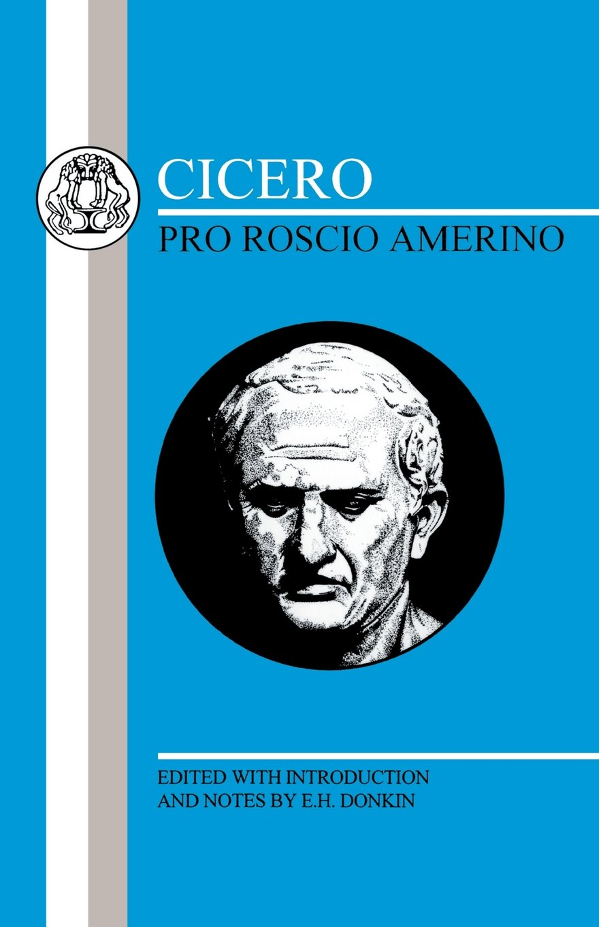
Cicero’s Life
After serving in the Roman army during the Social War between the Romans and Italians (89-88 BCE), Cicero learned that he was not suited for the military life.
Over time, he began to refine his rhetorical skills. Finally, in 80 BCE he took on his first criminal case . Sextus Roscius was falsely accused of killing his father during the Sullan proscriptions, in order that Chrysogonus, one of Sulla’s henchmen, could procure the man’s estate for a small some of money. With a victory, Cicero burst into the political arena.
After these criminal proceedings, in which Cicero successfully never casted a light on Cataline, Cicero spent two years abroad in order to “restore his health”.

Slide 6

Cicero’s Early Career and the Cursus Honorum
Upon his return to Rome in 77 BCE, Cicero served one of the quaestorships for 76 BCE. This made Cicero the first in his family to serve in the Roman Senate. Ergo he was a “novus homo”.
His quaestorship in Sicily proved to be successful when the Sicilians begged Cicero to prosecute their governor Verres for extortion seven years later in 70 BCE.
In this case against Verres, who left Sicily the day after Cicero began to deliver his accusations against him, Cicero defeated Rome’s most revered orator of the time; Quintus Hortensius Hortalus.
Cicero was elected aedile in 69 BCE and praetor in 66 BCE.
During his praetorship a tribune Gaius Manlius proposed a bill which would give unrestricted authority to Pompey Magnus for the campaign against Mithridates. Pompey, who just smashed the Mediterranean pirates, was a great military leader. Cicero supported this bill to be in the good graces of Pompey in order to have his backing for a bid as consul.

Slide 7
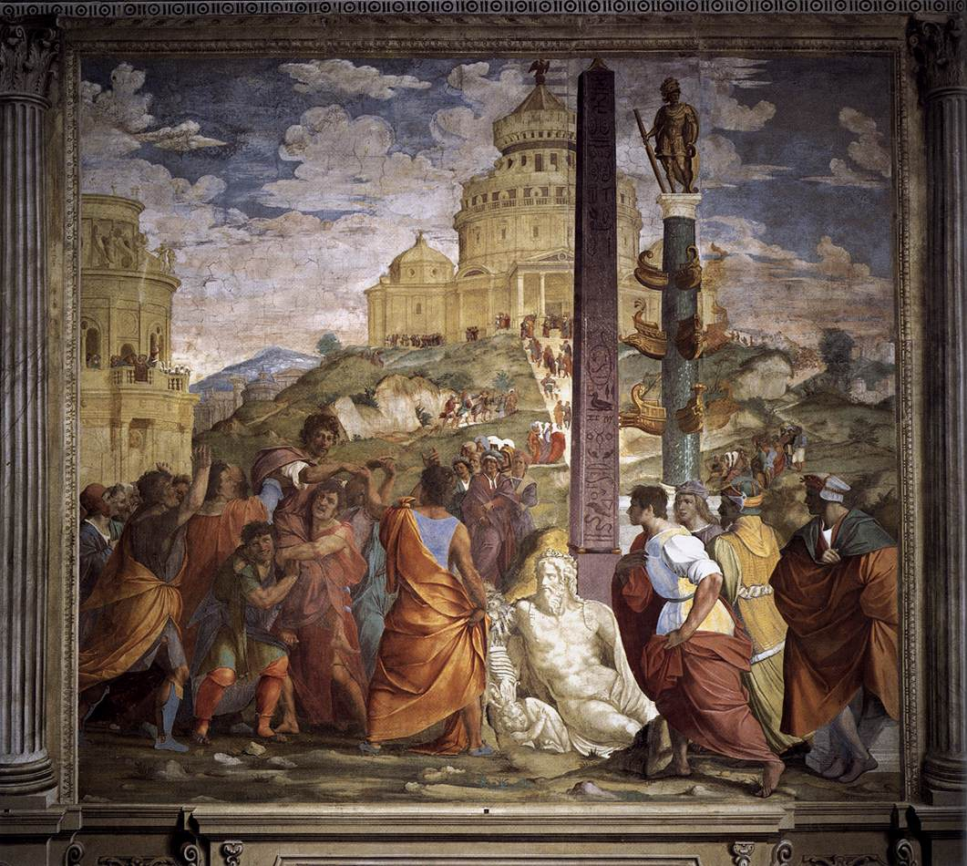
Cicero the Consul
Cicero was elected into the consulship in 63 BCE. This is the same year in which he dealt with the conspiracy of Cataline.
Lucius Sergius Catalina, a political who was habitually unsuccessful at attaining the consulship, gathered an army to overthrow the Roman state.
Thanks to Cicero’s exposure of Cataline to the Senate, the senators enacted the senatus consultum ultimum (the ultimate decree) which gives the consuls all authority to protect the state.
After delivering three speeches against Cataline, Cicero convinced him to leave Rome whereupon Cataline fled to Etruria to gather his army. There Cataline later died in battle.
The five conspirators who remained in Rome were executed without a trial. This action later led to Cicero’s exile.
Triumph of Cicero

Slide 8
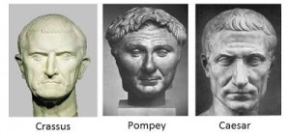
The First Triumvirate and Cicero’s Exile
In 60 BCE, Caesar, Pompey, and Crassus formed the first triumvirate (3 consuls in the same term) in order to advance their political goals.
Cicero declined his invitation to become the 4th consul on the account that it was unconstitutional. Thus, Cicero began to be viewed as a threat by the triumvirs.
In 58, the Tribune Clodius Pulcher , an enemy of Cicero because of Cicero’s testimony against Clodius in the Bona Dea scandal, proposed a law that would banish anyone who executed Roman citizens without a trial. The law was passed and made retroactive.

Slide 9
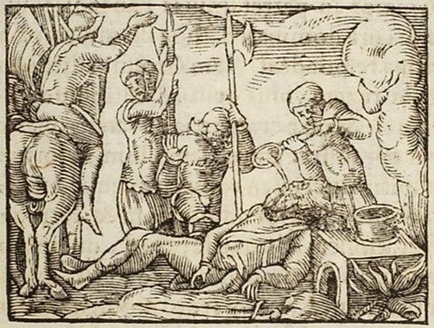
The First Triumvirate and Cicero’s Exile
In order to avoid prosecution, Cicero went into exile voluntarily where he remained for a year and a half.
In 57 BCE, the triumvirs recalled Cicero from exile for his influence in the senate.
Cicero, having felt obligated to repay the debt, began to support legislation which benefited the triumvirs as well as defending a few individuals in court who were supporters of the triumvirs.
In 54, with the death of Julia, daughter of Caesar and wife of Pompeii, the triumvirate began to disintegrate. Crassus died the following year at the hands of the Parthians.
Death of Crassus

Slide 10
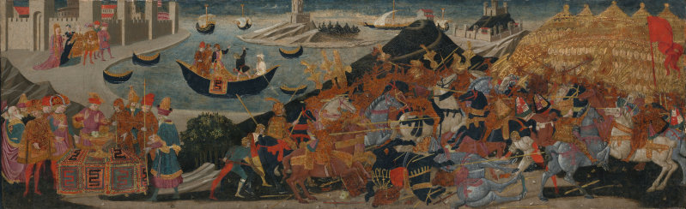
The First Triumvirate and Cicero’s Exile
With Caesar having rejected marriage to Pompey’s grandniece, Pompey re-established his allegiance with the conservatives.
This alliance eventually led to civil war between Pompey and Caesar in 49 BCE in which Cicero tried to remain neutral.
Out of loyalty to Pompey who worked tirelessly for Cicero’s recall from exile, Cicero traveled to Greece with Pompey and his supporters.
In 48 BCE at Pharsalus in Thessaly, Greece, Caesar defeated Pompey who then fled to Egypt for support. However, he was slain by the brother of Cleopatra.
Cicero eventually made it back to Italy where he and many supporters of Pompey were forgiven by Caesar.
Battle of Pharsalus and Death of Pompey

Slide 11

The Final Years of Cicero’s Life
The death of Cicero’s daughter Tullia in 45 BCE inspired Cicero’s works on philosophy such as De amicitia, De senectute, etc.
The assassination of Julius Caesar in 44 BCE led to another power struggle which ended up in the hands of three men which created the second triumvirate: Octavian (adopted son/great nephew), Marc Antony (right hand man in Gaul/Consul during the time of Caesar’s death), and Marcus Lepidus (great supporter of Caesar and second-in-command).
Cicero delivered a series of speeches in the Curia known as Phillipics against March Antony (as Demosthenes had delivered speeches against Phillip II of Macedon) in an attempt to pit Antony against Octavian. Cicero claimed that Antony was an enemy of the state in support for the Republic.

Slide 12
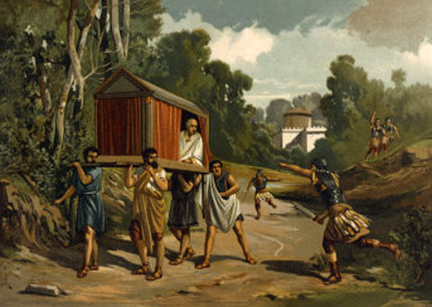
The Final Year‘s of Cicero’s Life
One of the first motions of the triumvirs was to set up a proscription. It should be of no surprise that Cicero’s 14 speeches delivered against Antony resulted with his name on the list.
In an attempt to flee from Italy to Macedonia, he was overtaken by Antony’s soldiers at this villa in Formiae.
Upon his assassination, his hands and head were put on display up over the rostra as a warning to those who may oppose the Second Triumvirate.
Cicero was assassinated in 43 BCE.
Assassination of Cicero

Slide 13
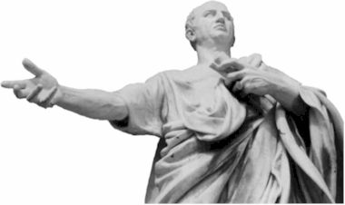
Cicero and Oratory
Romans highly valued the ability to persuade since the process of debate and persuasion was essential in maintaining the republic.
The Romans modeled the art of rhetoric and oratory from the Greeks to such an extent that they hired educated Greeks as tutors both public and private.
Rhetoric and oratory were essential skills in the political arena and important for one who wanted to ascend the cursus honorum.
Two types of oratory were popular during Cicero’s time: Attic and Asiatic (the more popular of the two). The Asiatic style focused on rapid flow, verbal embellishment, and figures of speech. It focused on pompousness and wordiness. The Attic style focused on energy, taste, restraint, and refinement rather than showiness.

Slide 14
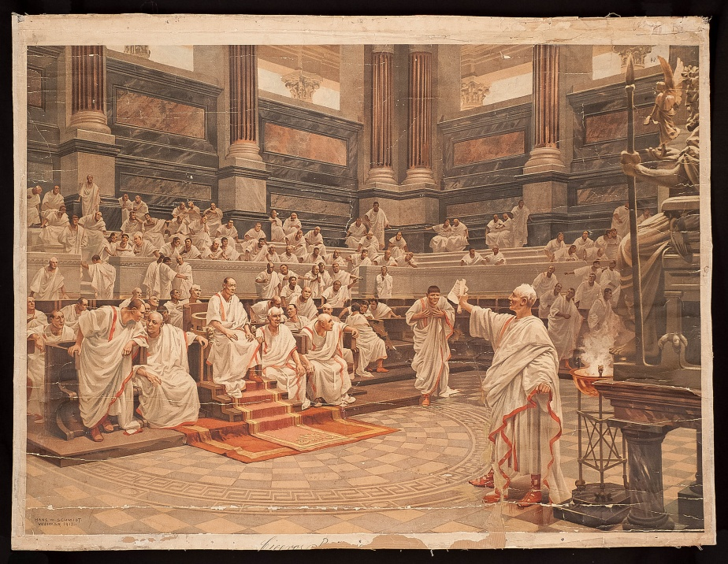
Cicero and Oratory
Cicero studied both styles and then developed one of his own.
All styles of oratory focused on having their sentences form a series of independent clauses (parataxis).
e.g. immo vero etiam in senatum venit, fit publici consili particeps, notat et designat oculis ad caedam unum quemque nostrum.
However, subordinated clauses and ideas (hypotaxis) are more typical in Cicero’s speeches.
e.g. Hac tanta celebritate famae cum esset iam absentibus notus, Romam venit Mario consule et Catulo.
Cicero’s innovative style excited his audiences: Longinus likened Cicero’s style to a wildfire that rolls on and on, devouring everything in its path.

Slide 15
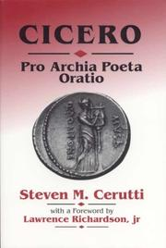
Cicero’s Pro Archia Poeta and Aulus Licinius Archias
Born in Antioch, Syria, in 119 BCE, Archias earned a reputation for his poetic improvision. Arriving in Rome in 102 BCE, he gained favor among Rome’s elite. The Luculli were instrumental in helping Archias acquire his citizenship in 89 BCE.
In 62 BCE, Archias was accused by a prosecutor, Grattius, for illegally acquiring his citizenship. His real purpose was to embarrass Archias’s patron family, the Luculli.
Cicero defended Archias in court for a twofold purpose: to defend his old teacher (Archias), and to gain favor with the Luculli.
Cicero’s defense had two points; there was no proof of Archias acquiring citizenship illegally, and how literary study supports the public welfare and how Archias extended the glory of Rome through his poetry.

Slide 16
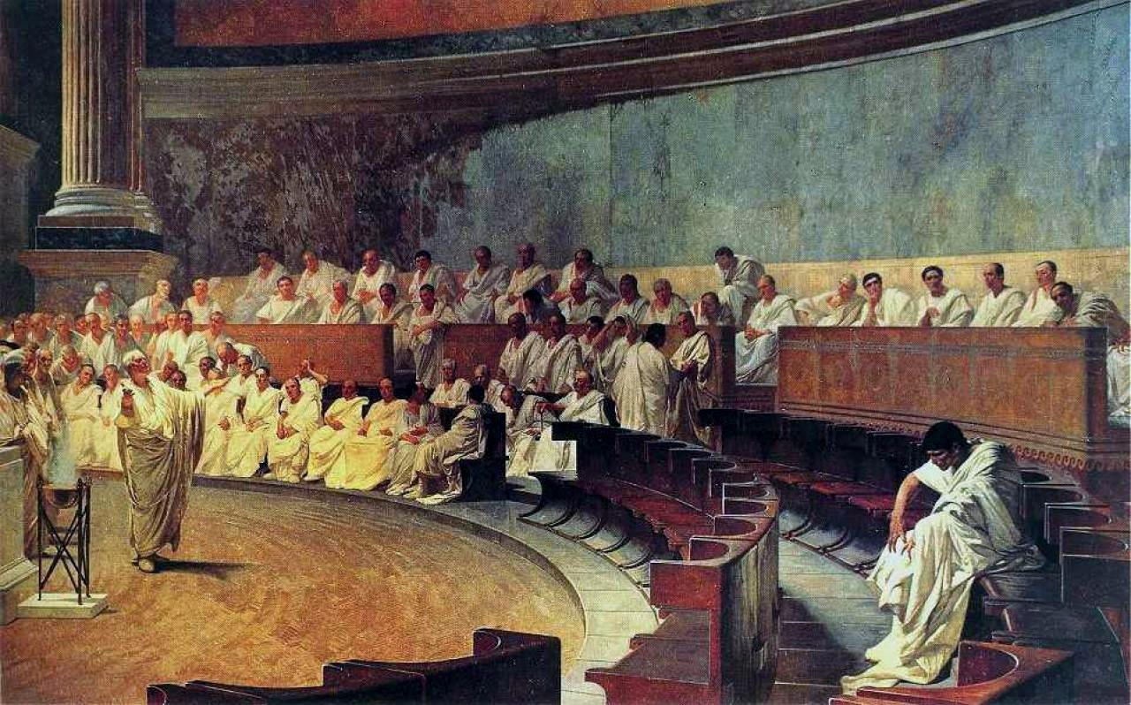
In Catalinam I
Cataline was born around 108 BCE to a patrician family which had fallen into poverty.
Cataline climbed the cursus honorum and in 67 BCE served a pro-praetorship in Africa. Accused of extortion in 65 BCE, he was later acquitted. However, he did not pursue the consulship in 64 BCE.
“Salty” for having lost the consulship to Cicero and Hybrida in 63 BCE, he gathered all the disgruntled aristocrats, nights, and Sullan veterans in a plot to overthrow the state.
Cicero was informed of the plots by spies. The day after Cataline tried to take Cicero’s life, Cicero summoned an emergency meeting in the temple of Jupiter Stator (much easier to fortify than the Curia). Cicero wanted to compel the senators of the danger and for Cataline to leave Rome.

